Slide 1

CO1-AT3-TECHNICAL PRESENTATION
CSA0509 : Database Management Systems
GUIDED BY
Dr. C. Kesavan
PRESENTED BY :
GUNAVATHI A(192511374)

Slide 2


INTRODUCTION
Q1. Create and present an ER diagram for an Online Library System, explaining each component clearly
An Online Library System is a software application that manages books, members, and borrowing activities digitally.
An ER Diagram shows the entities, their attributes, and the relationships between them.
It helps design an efficient database by organizing data clearly and reducing redundancy.

Slide 3
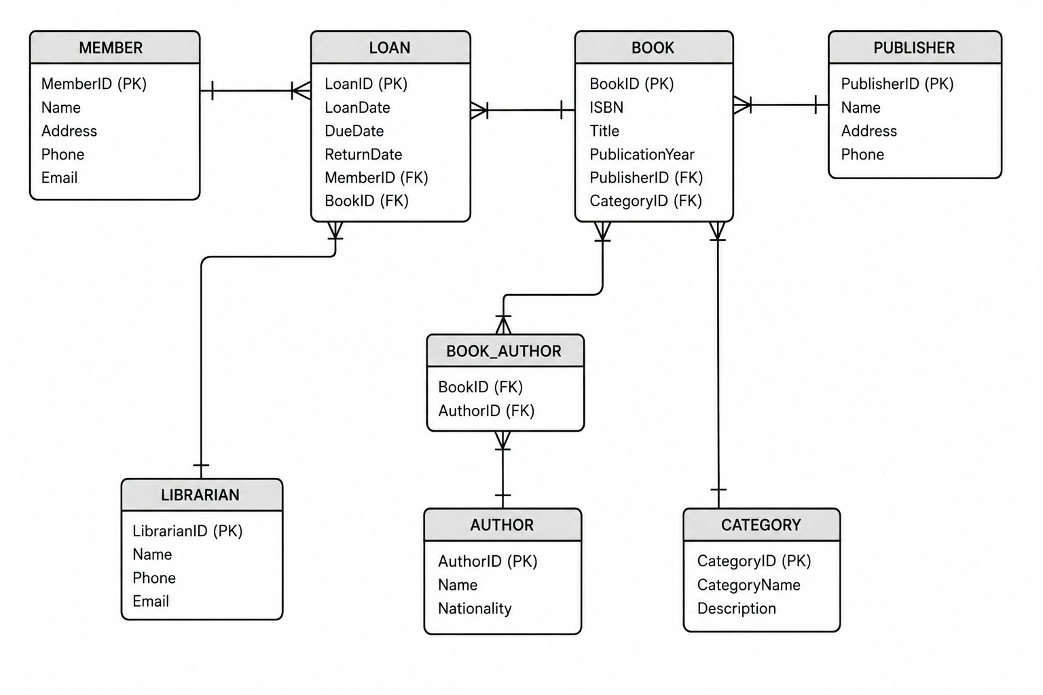
ER DIAGRAM

Slide 4
COMPONENTS
Entities
Member – Represents a registered user who can search, borrow, and return books.
Book – Contains details of books available in the library, such as title, ISBN, and publication year.
Category – Represents the genre or classification of books, such as Fiction, Science, or History.
Reservation – Stores information about books reserved by members when they are currently unavailable.
Fine – Maintains records of penalties charged for overdue or lost books.
Librarian – Represents the staff responsible for managing books, members, and library transactions.
Relationships
Member → Loan: Borrows books (1:M)
Book → Loan: Loan records (1:M)
Author ↔ Book: Writes books (M:N)
Publisher → Book: Publishes books (1:M)
Librarian → Loan: Processes loans (1:M)
Attributes
Member: Member_ID, Name, Email, Phone
Book: Book_ID, Title, ISBN, Category
Author: Author_ID, Author_Name
Publisher: Publisher_ID, Publisher_Name
Loan: Loan_ID, Issue_Date, Due_Date, Return_Date
Librarian: Librarian_ID, Name, Phone

Slide 5
ADVANTAGES
Easy management of books and members.
Fast book issue and return process.
Reduces paperwork and manual errors.
Maintains accurate borrowing records.
Makes book searching faster.
Improves data accuracy and organization.
CONCLUSION
The Online Library System makes library management easy and efficient.
The ER Diagram shows the entities, attributes, and relationships clearly.
It helps organize data accurately and reduces duplication.
Overall, it provides a simple, reliable, and efficient database for library management.

Slide 6
INTRODUCTION
Q2. Prepare a presentation on the EER model, demonstrating generalization and specialization with a University case study.
The Extended Entity-Relationship (EER) Model is an advanced version of the ER model.
It is used to design complex databases.
The EER model includes Generalization, Specialization, and Inheritance.
It helps organize data efficiently and reduces duplication.
In a University system, Person is divided into Student, Faculty, and Staff.

Slide 7
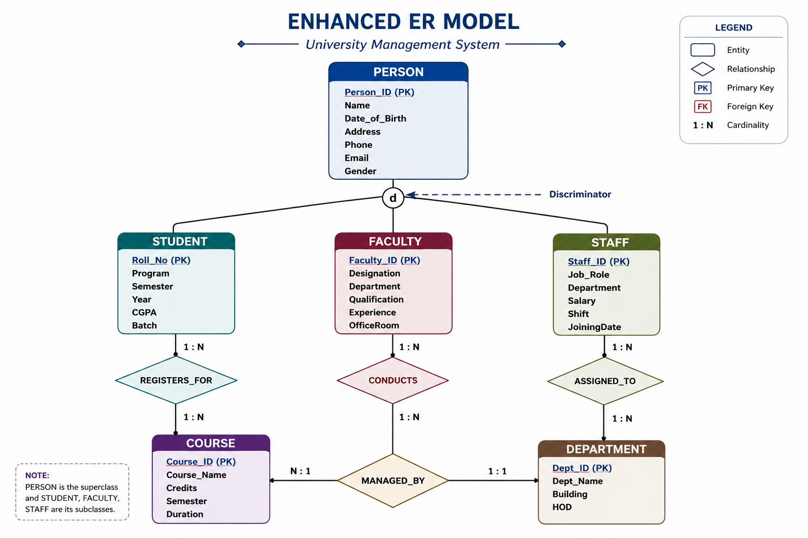
UNIVERSITY CASE STUDY:

Slide 8
COMPONENTS
Superclass
Person :Common entity that stores shared information.
Subclasses
Student – Stores student details.
Faculty – Stores faculty details.
Staff – Stores staff details.
Generalization
Combines similar entities into one Superclass (Person).
Specialization
Divides Person into Student, Faculty, and Staff based on their roles.
Inheritance
Student, Faculty, and Staff inherit common attributes from Person

Slide 9
ADVANTAGES
Reduces data duplication.
Organizes data in a better way.
Represents real-world situations clearly.
Makes the database easy to manage.
Improves database design and maintenance.
CONCLUSION
The EER Model is an advanced version of the ER model.
It uses Generalization and Specialization to organize data efficiently.
It reduces data redundancy and improves database structure.
In the University case study, Person is divided into Student, Faculty, and Staff.
Overall, the EER model helps create a simple, efficient, and well-organized database.

Slide 10
INTRODUCTION
Q3. Present the concept of data independence (logical and physical) and its significance in DBMS architecture.
Data independence is the ability to change the database structure without affecting application programs.
It is an important feature of a Database Management System (DBMS).
There are two types of data independence: Logical and Physical.
It improves database flexibility, maintenance, and performance.

Slide 11
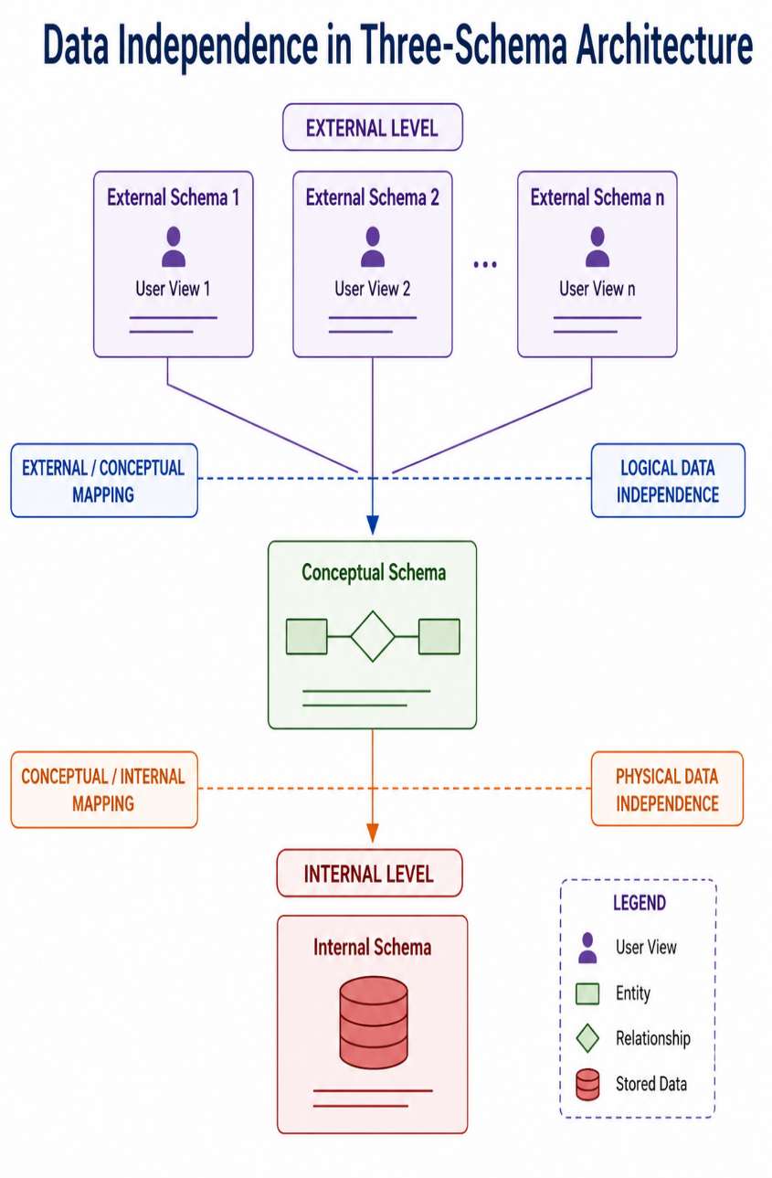
TYPES OF DATA INDEPENDENCE
Logical Data Independence
Ability to change the logical structure without affecting user applications.
Example:
Adding a new column (Email) to the Student table.
Existing programs continue to work without modification.
Physical Data Independence
Ability to change the physical storage without affecting the logical structure.
Example:
Creating an index to improve search speed.
Changing file organization or storage device.

Slide 12
ADVANTAGES& CONCLUSION
Reduces maintenance cost.
Improves database security.
Increases flexibility.
Allows easy database updates.
Enhances system performance.
Data independence is an important feature of DBMS.
It separates applications from the database structure.
Logical data independence protects applications from logical changes.
Overall, it makes the database more flexible, efficient, and easy to maintain.

Slide 13
INTRODUCTION
Q4. Deliver a technical presentation on the software components of a DBMS, explaining query processor, storage manager, and transaction manager
A Database Management System (DBMS) is software used to store, manage, and retrieve data.
It helps users access data quickly and securely.
A DBMS consists of different software components that work together.
The main components are Query Processor, Storage Manager, and Transaction Manager.

Slide 14
COMPONENTS
Query Processor
Accepts SQL queries from users.
Checks the query for errors.
Optimizes the query.
Executes the query efficiently.
Storage Manager
Manages the storage of data in the database.
Retrieves data whenever requested.
Maintains files, indexes, and memory.
Ensures data is stored securely and efficiently.
Transaction Manager
Controls database transactions.
Maintains ACID properties.
Prevents data loss and inconsistency.
Handles commit and rollback operations.

Slide 15
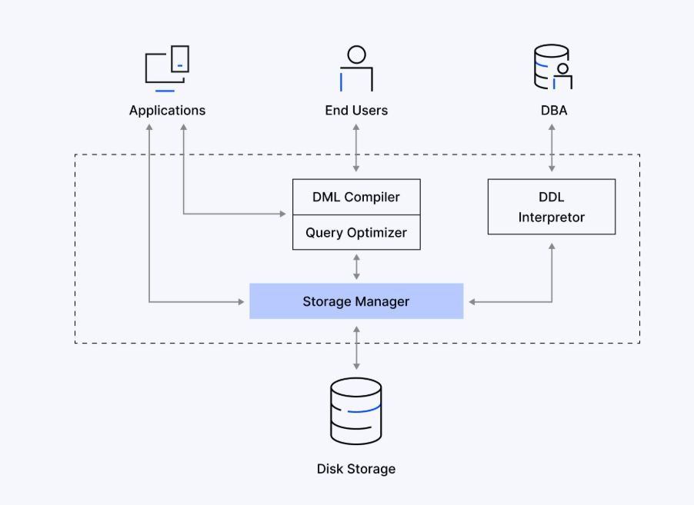
WORK FLOW & DIAGRAM
User sends an SQL query.
Query Processor checks and executes the query.
Transaction Manager manages the transaction safely.
Storage Manager accesses the required data.
The result is returned to the user.

Slide 16
CONCLUSION
The Query Processor processes SQL queries.
The Storage Manager manages data storage and retrieval.
The Transaction Manager ensures safe and reliable transactions.
All three components work together for efficient database management.
They make the DBMS fast, secure, and reliable.

Slide 17
INTRODUCTION
Q5.Prepare a presentation comparing strong and weak entities in ER modeling with real-world examples.
An Entity is an object or thing that stores data in a database.
There are two types of entities: Strong Entity and Weak Entity.
A Strong Entity has its own primary key.
A Weak Entity depends on a strong entity for identification.
ER modeling uses both entities to represent real-world data accurately.

Slide 18
Comparison Table
Strong Entity | Weak Entity
Has its own Primary Key | Does not have its own Primary Key
Exists independently | Depends on a Strong Entity
Represented by a single rectangle | Represented by a double rectangle
Primary key uniquely identifies records | Uses a partial key with the owner's key
Example: Student, Employee | Example: Dependent, Order Item

Slide 19
COMPONENTS
Strong Entity
Exists independently.
Has its own Primary Key.
Example: Student, Employee, Book.
Weak Entity
Depends on a Strong Entity.
Does not have a complete Primary Key.
Example: Dependent, Order Item.
Relationship
Strong Entity identifies the Weak Entity.
The Weak Entity cannot exist without the Strong Entity.

Slide 20
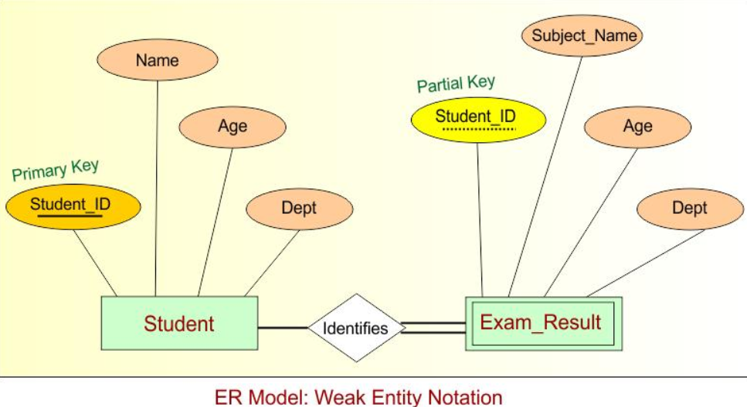
STRONG & WEAK ENTITIES

Slide 21
CONCLUSION
A Strong Entity has its own primary key and exists independently.
A Weak Entity depends on a strong entity for identification.
Both entities help represent real-world scenarios correctly.
They improve the accuracy and organization of database design.
ER modeling makes databases simple, efficient, and reliable.

